Slide 1
Patient Case Similarity
PIP2001 Capstone Project
Review-0
Batch Number:CEI-08
Roll Number | Student Name
20211CEI0121 | PASALA JASWANTH
20211CEI0137 | P ABHINAY KUMAR
20211CEI0152 | Y AKSHATH KUMAR REDDY
20211CEI0153 | PERISETTY UDAYKIRAN
Under the Supervision of,
Dr. P Sudha
Professor / Associate Professor / Assistant Professor
School of Computer Science and Engineering (COM&CEI)
Presidency University
Name of the Program: Computer Engineering AI and ML(CEI)
Name of the HoD: Dr. Gopal Sam
Name of the Program Project Coordinator: P Sudha Expert: AI, ML and Application Development
Name of the School Project Coordinators: Dr. Sampath A K / Dr. Abdul Khadar A / Mr. Md Ziaur Rahman

Slide 2
Content
Problem Statement
Analysis of Problem Statement
Timeline of the Project
References

Slide 3
Problem Statement Number:
Organization: ezDI - Healthcare & Biomedical Devices
Category (Hardware / Software / Both) : Software
Problem Description : Analyze EHR data using Machine Learning to assist Clinicians and Researchers.
Difficulty Level: Machine Learning + Web / Mobile App (Medium)

Slide 4
Analysis of Problem Statement
Web Application Summary:
Purpose: Calculation of Patient Similarity based on Patient Demographic and Case Details extracted from XML annotations, Electronic Health Record (EHR)
Features:
User Registration/Login: Users register by role (Researcher or Doctor) and log in.
Researcher Interface:
Query the database for patient similarity scores.
Conduct medical research, case-control studies, and clinical trials.
Doctor Interface:
Query using patient symptoms to classify and find similar cases.
Use findings for diagnosis and treatment recommendations.
Technical Aspects:
Patients are clustered based on medical conditions.
Similarity scores are assessed using RMSE for accuracy.

Slide 5
Analysis of Problem Statement (contd...)
Certainly! When it comes to finding similarity between patient cases, there are a few key aspects to consider. Could you clarify what type of patient cases you're interested in? For example:
Medical Conditions: Are you looking for similarities in terms of symptoms, diagnoses, or treatment responses?
Treatment Outcomes: Are you focusing on how different patients with the same condition respond to the same treatment?
Demographic Factors: Are you comparing cases based on age, gender, lifestyle, or other demographic information?
Medical History: Are you interested in how patients with similar past medical histories fare with certain conditions or treatments?

Slide 6
Analysis of Problem Statement (contd...)
METHODOLOGY:
The proposed Flask web app integrates modern web development, machine learning (ML), and natural language processing (NLP) to address healthcare tech gaps, enhancing medication recommendations and disease predictions. ML algorithms, like Random Forests or Neural Networks, decode intricate health data trained on extensive patient datasets. NLP analyzes patient-reported symptoms, transforming natural language inputs for precise ML interpretation. The Flask UI ensures accessibility for users with varying technical expertise, seamlessly connecting with ML and NLP for real-time predictions in healthcare.
Data Acquisition and Preprocessing
Machine Learning Model Development
Natural Language Processing for Symptom Analysis
Development of the Flask Web Application
Validation and Testing

Slide 7
Timeline of the Project
S.No | Review | Dates
1 | Review-0 | 18-09-2024
2 | Review-01
3 | Review-02
4 | Review-03
5 | Final Viva Voice

Slide 8
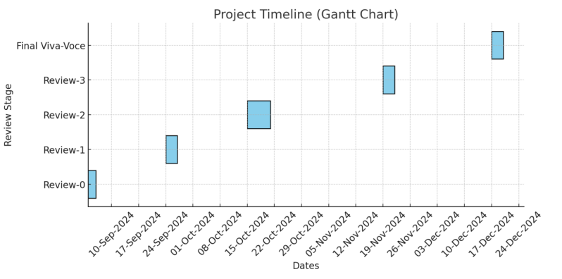
Timeline of the Project (Gantt Chart)

Slide 9
References (IEEE Paper format)
NLP Project developed for Grand Finale (National Level, Software Edition) of Smart India Hackathon 2019 for ezDI.
An ensemble model consisting of both Word Mover’s Distance (WMD) and General Feature Extraction

Slide 10


